Slide 1
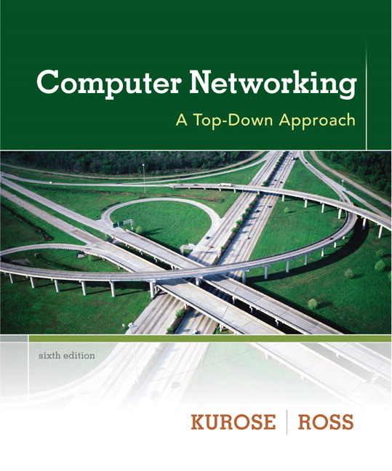


Chapter 5 Link Layer
Computer Networking: A Top Down Approach 6th edition Jim Kurose, Keith Ross Addison-Wesley March 2012
A note on the use of these ppt slides:
We’re making these slides freely available to all (faculty, students, readers). They’re in PowerPoint form so you see the animations; and can add, modify, and delete slides (including this one) and slide content to suit your needs. They obviously represent a lot of work on our part. In return for use, we only ask the following:
If you use these slides (e.g., in a class) that you mention their source (after all, we’d like people to use our book!)
If you post any slides on a www site, that you note that they are adapted from (or perhaps identical to) our slides, and note our copyright of this material.
Thanks and enjoy! JFK/KWR
All material copyright 1996-2012
J.F Kurose and K.W. Ross, All Rights Reserved

Slide 2



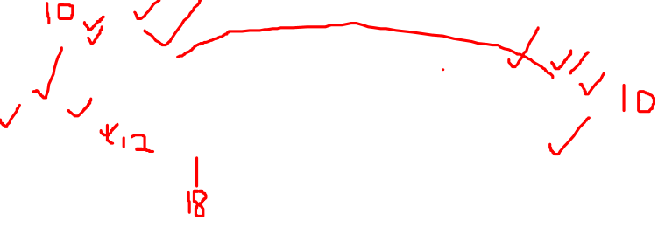
VLANs: motivation
consider:
CS user moves office to EE, but wants connect to CS switch?
single broadcast domain:
all layer-2 broadcast traffic (ARP, DHCP, unknown location of destination MAC address) must cross entire LAN
security/privacy, efficiency issues
Computer
Science
Computer
Engineering
Electrical
Engineering

Slide 3

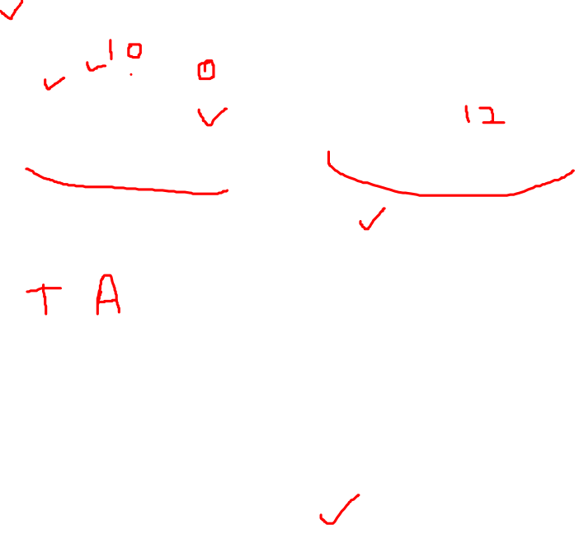
VLANs
port-based VLAN: switch ports grouped (by switch management software) so that single physical switch ……
Virtual Local
Area Network
1
7
9
15
2
8
10
16
switch(es) supporting VLAN capabilities can be configured to define multiple virtual LANS over single physical LAN infrastructure.
…
…
Electrical Engineering
(VLAN ports 1-8)
Computer Science
(VLAN ports 9-15)
… operates as multiple virtual switches
1
7
9
15
2
8
10
16
…
…
Electrical Engineering
(VLAN ports 1-8)
Computer Science
(VLAN ports 9-16)

Slide 4

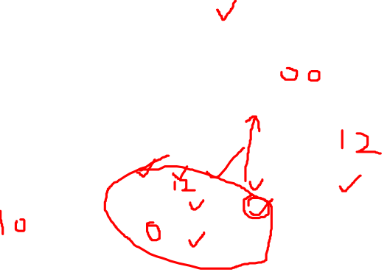
Port-based VLAN
router
traffic isolation: frames to/from ports 1-8 can only reach ports 1-8
can also define VLAN based on MAC addresses of endpoints, rather than switch port
1
7
9
15
2
8
10
16
dynamic membership: ports can be dynamically assigned among VLANs
…
…
Electrical Engineering
(VLAN ports 1-8)
Computer Science
(VLAN ports 9-15)
forwarding between VLANS: done via routing (just as with separate switches)
in practice vendors sell combined switches plus routers

Slide 5
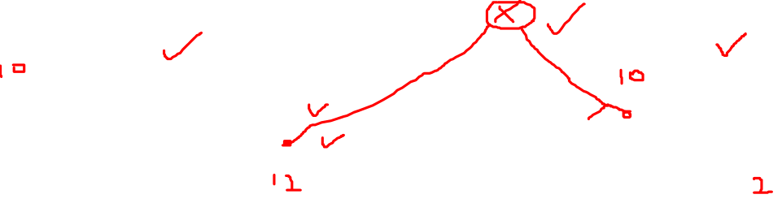
VLANS spanning multiple switches
1
7
9
15
1
3
5
7
2
8
10
16
2
4
6
8
…
…
Electrical Engineering
(VLAN ports 1-8)
Computer Science
(VLAN ports 9-15)
Ports 2,3,5 belong to EE VLAN
Ports 4,6,7,8 belong to CS VLAN
trunk port: carries frames between VLANS defined over multiple physical switches
frames forwarded within VLAN between switches can’t be vanilla 802.1 frames (must carry VLAN ID info)
802.1q protocol adds/removed additional header fields for frames forwarded between trunk ports

Slide 6

802.1Q VLAN frame format
type
preamble
dest.
address
source
address
data (payload)
CRC
802.1 frame
type
preamble
dest.
address
source
address
data (payload)
CRC
802.1Q frame
2-byte Tag Protocol Identifier
(value: 81-00)
Recomputed
CRC
Tag Control Information (12 bit VLAN ID field,
3 bit priority field like IP TOS)

